Slide 1



Can you predict the future? Introduction to the NEON Forecasting Challenge ESA workshop 3 Monday 7th August 2023
Workshop lead: Freya Olsson Virginia Tech, USA (freyao@vt.edu)
Notes:
Text highlighted in pink should be modified where appropriate.
Slides relating specifically to the terrestrial theme are hidden but can be used in place of those about the aquatics theme

Slide 2
Workshop overview
Objectives:
Highlight some key concepts of ecological forecasting
Introduce NEON and the Forecasting Challenge
Walk through a simple forecast workflow
Point to resources to get involved and find more information

Slide 3
Workshop Overview
11:30-11.55 Introductory presentation
11.55-12.10 Break and R set-up
12:10-13:00 Hands-on coding/follow- along
Notes:
A rough schedule

Slide 4
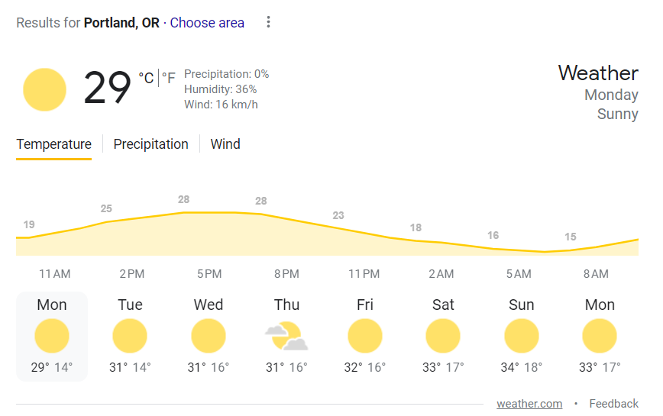
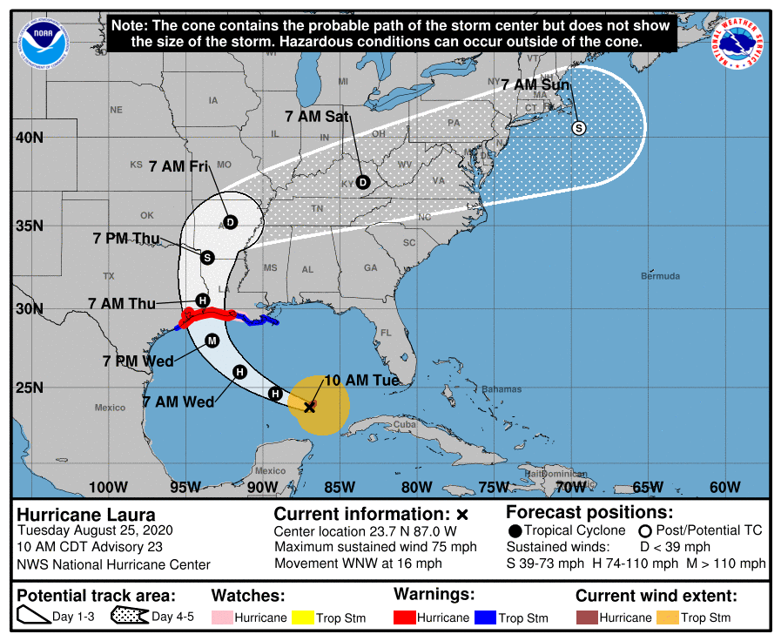
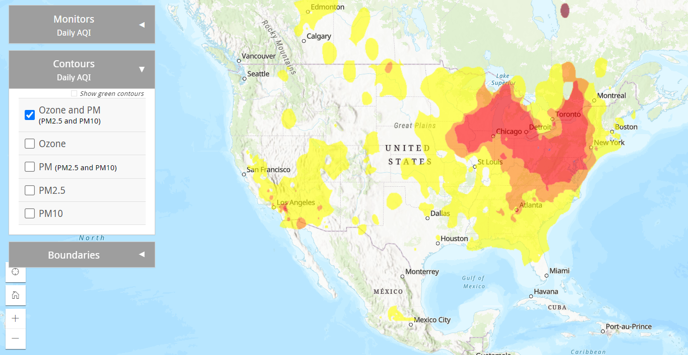
Why forecast?
Notes:
How many people looked at the weather this morning? Or last week when you were packing for your week in Portland? Also for emergency planning with natural disasters such as hurricanes. And more recently air quality forecasts for the wildfires and health concerns etc.
Similarly in ecology, these near term forecasts may prove be equally valuable for managing ecosystems and informing public

Slide 5
Near-term, iterative, ecological forecasts
Near-term = sub-daily to decadal timescales
Iterative = process of repeatedly validating forecasts, updating model initial conditions and parameters, and issuing new forecasts as new data become available
Ecological forecast = future predictions of physical, chemical, or biological variables with quantified uncertainty

Slide 6

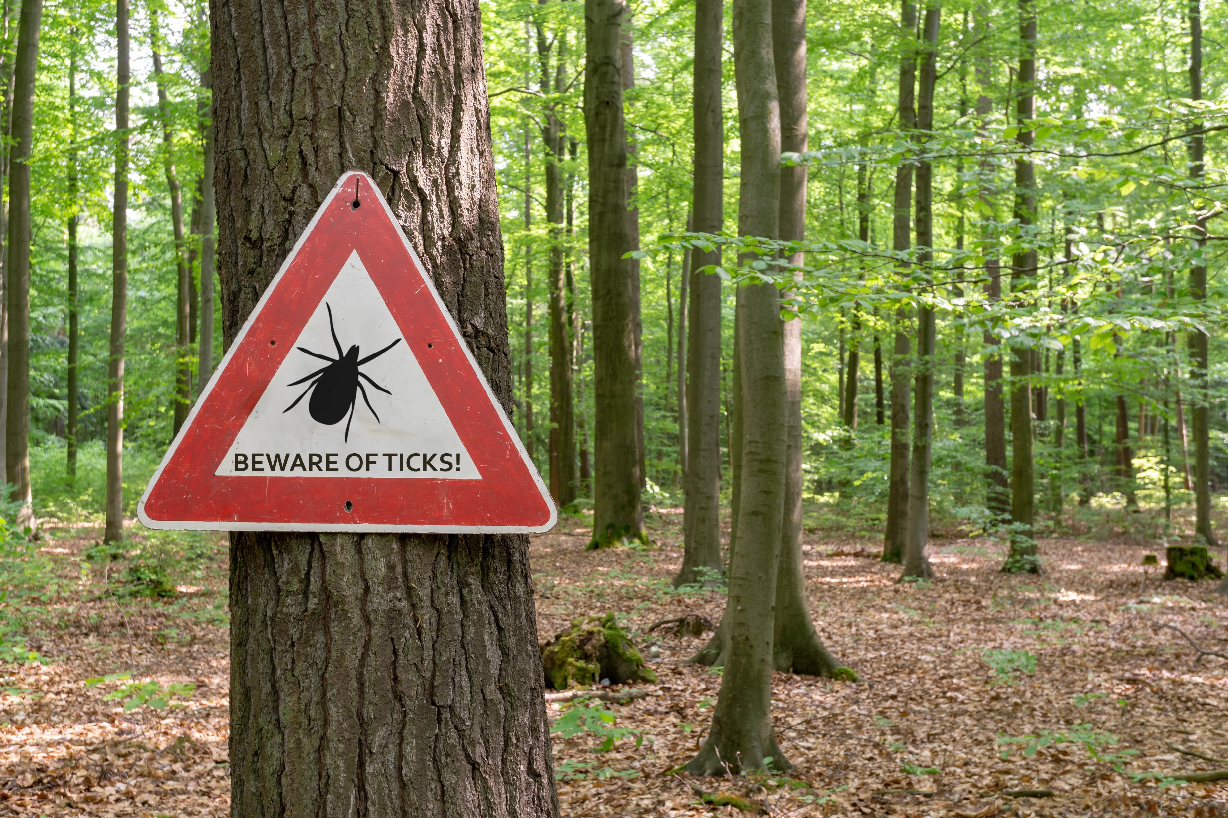
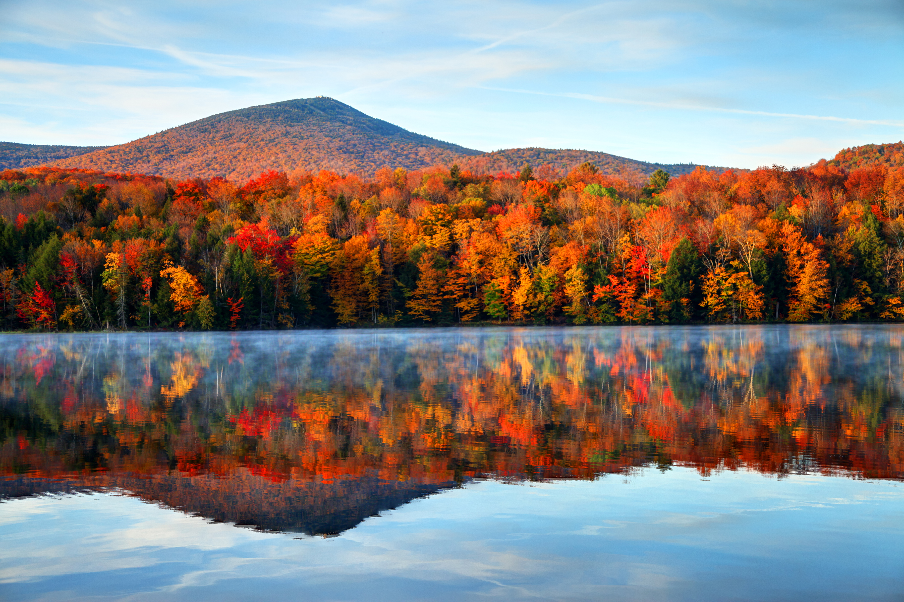
Examples:
Getty Images/iStockphoto
Getty Images/iStockphoto
Forecast of river dissolved oxygen concentration for the next 1-48 hours for fish stocking
1-3 month ahead predictions of the % chance of leaf fall to estimate peak leaf-peeping
Forecasts of tick abundance for the next 1-30 days in a popular hiking area
Getty Images/iStockphoto
Notes:
Some examples of ecological forecasts

Slide 7
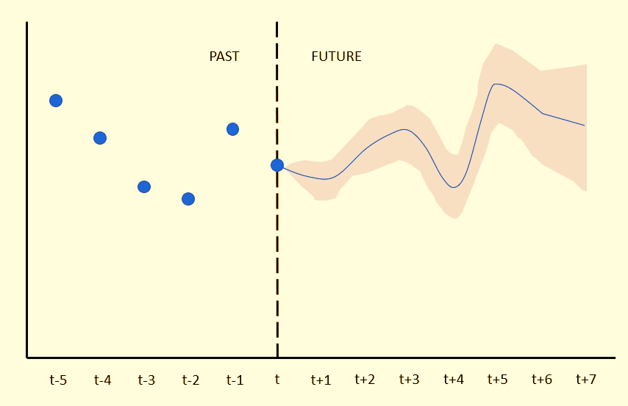
Ecological variable
Notes:
Example of what we means by a forecast. Past observation as points, future prediction (generated at dotted line), with uncertainty

Slide 8
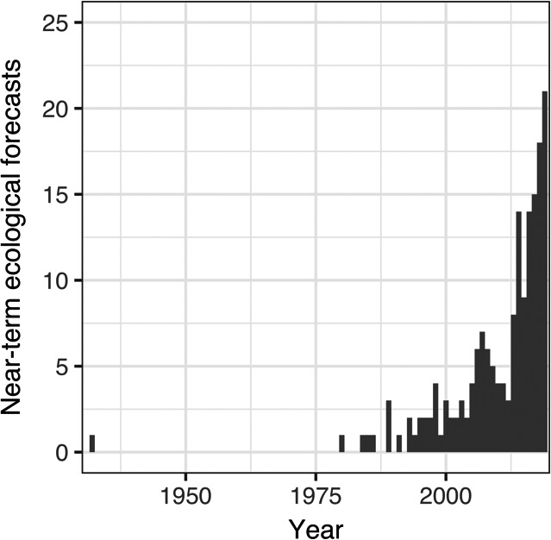
Ecological forecasting
An emerging and growing field
Lewis et al., 2021 (https://doi.org/10.1002/eap.2500)
Notes:
A relatively new field but one that has the potential to have both applied and fundamental outcomes.
Lots to learn about predictability, best methods

Slide 9
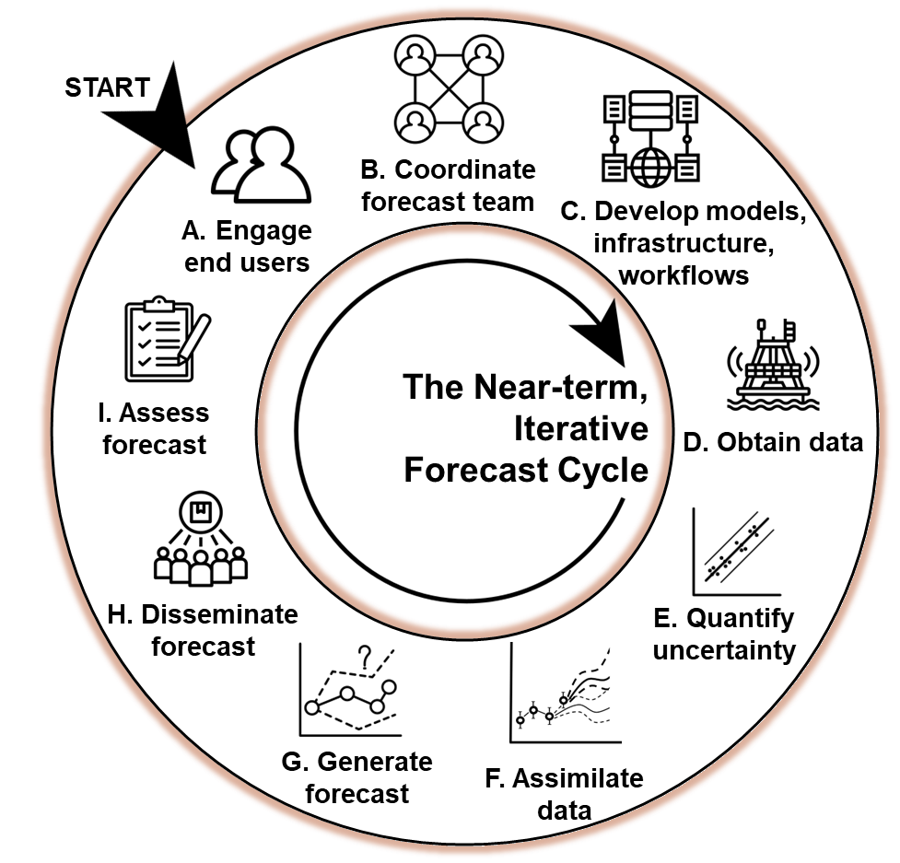
Forecasting Challenges
Forecasting is challenging!
Lofton, M. E et al. (2023) https://doi.org/10.1111/gcb.16590
A Challenge to catalyze progress
Notes:
The endeavour of producing a real-time forecast is not easy given the infrastructure needed to collect, disseminate data, develop and deploy models, evaluate and distribute forecasts to end-users. Plus the need to do this in a reproducible and repeatable way.
In other fields such as economics and computing competitions and challenge have been used as a way to forward the field and provide cohesion amongst researchers. An organising venture/enterprise for the community

Slide 10
Why a forecasting challenge? – the power of many forecasts!
A community of forecasting
Standards
Development of tools and infrastructure
A forecasting platform
2. Answer questions of predictability
Predictability
Variables
Models
Sites
Horizon, lead time
The EFI-NEON Forecasting Challenge was born (2021)!
Notes:
A Challenge has two potential values:
Generates a community of forecasters with common standards of production, submission, evaluation etc.
Start to answer questions of predictability across a range of scales (models, sites, variables). NEON data is perfect for this

Slide 11

Ecological Forecasting Initiative Research Co-ordination Network
EFI RCN Goals
lower barriers
community building
infrastructure
platform development
EFI RCN supported by NSF grant DEB-1926388
Notes:
Challenge coordinated by the Ecological Forecasting Initiative Research Coordination Network as a means to engage more people
Partnered with NEON for the Challenge

Slide 12
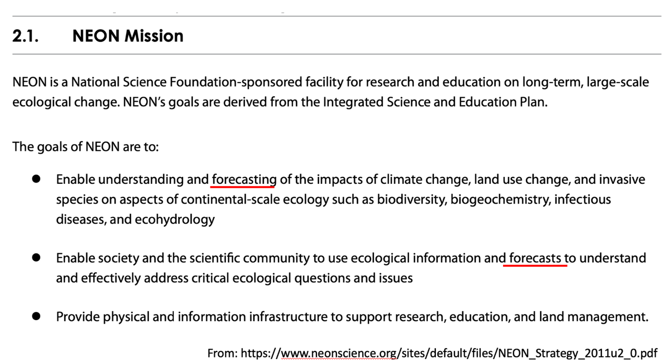
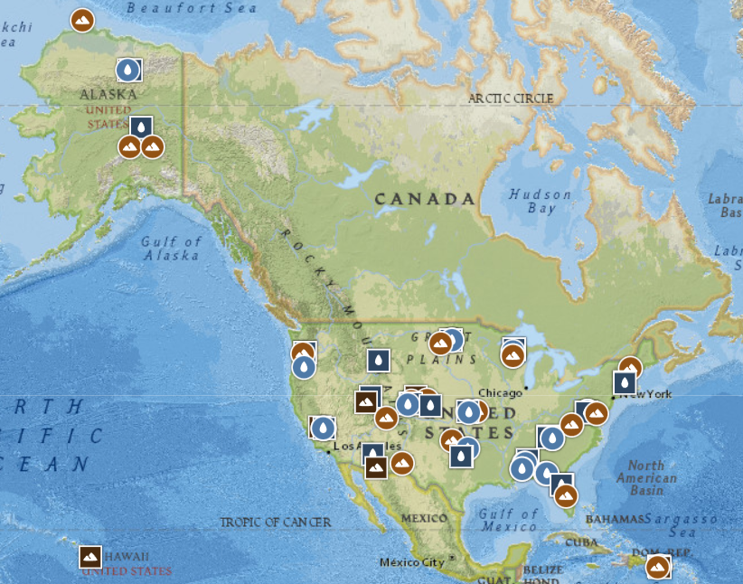


What is ?
The National Ecological Observatory Network (NEON) is a continental-scale observation facility
To collect long-term open access ecological data
47 terrestrial and 34 aquatic sites
NEON sites across the US
Notes:
Leverages the continental scale ecological observatory network that collects data across the US from 81 different sites
NEON justification in early 2000s, in the NEON mission – to forecast ecosystems a key goal

Slide 13
What is the EFI-NEON Challenge?
ticks
beetles
phenology
terrestrial
aquatics
Forecasting Challenge Themes
“A platform for the community to make predictions of conditions at NEON sites before the data are collected”
All 81 sites
6 themes
Notes:
The Challenge covers 5 themes across ecology: Ticks, beetles, phenology, terrestrial daily, terrestrial subdaily, aquatics
Created a platform for the ecological forecasting community to make

Slide 14
What is the EFI-NEON Challenge?
“A platform for the community to make predictions of conditions at NEON sites before the data are collected”
All 81 sites
6 themes
> 15,000 forecast submitted!
Forecast = A prediction of future environmental conditions that includes quantified uncertainty
Thomas, et al. (2023). The NEON Ecological Forecasting Challenge. Frontiers in Ecology and the Environment, 21(3), 112–113. https://doi.org/10.1002/fee.2616
Notes:
Created a platform for the ecological forecasting community to make forecasts and do synthesis
More information on the Challenge at Thomas et al 2023

Slide 15
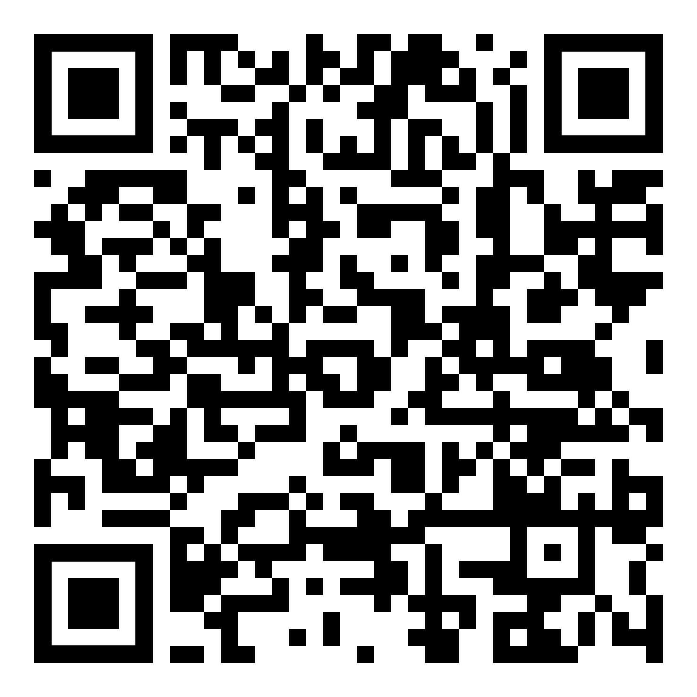
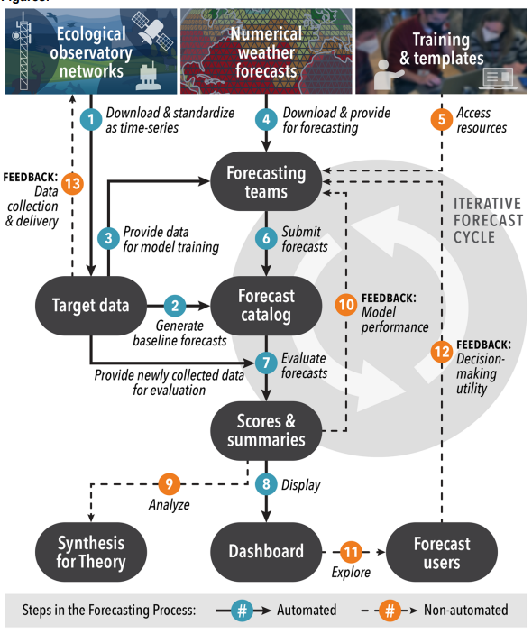
Challenge overview
Thomas, et al. (2023). The NEON Ecological Forecasting Challenge. Frontiers in Ecology and the Environment, 21(3), 112–113. https://doi.org/10.1002/fee.2616
Notes:
Walkthrough the steps of the challenge. We are focusing on Forecasting Teams submitting forecasts. The CI implemented by organisers has taken care of a lot of the rest of the workflow
Full paper at QR code

Slide 16
Workshop overview
Objectives:
Highlight some key concepts of forecasting
Introduce NEON and the Forecasting Challenge
Walk through a simple forecast workflow
Point to resources to get involved and find more information
Notes:
Time for questions

Slide 17
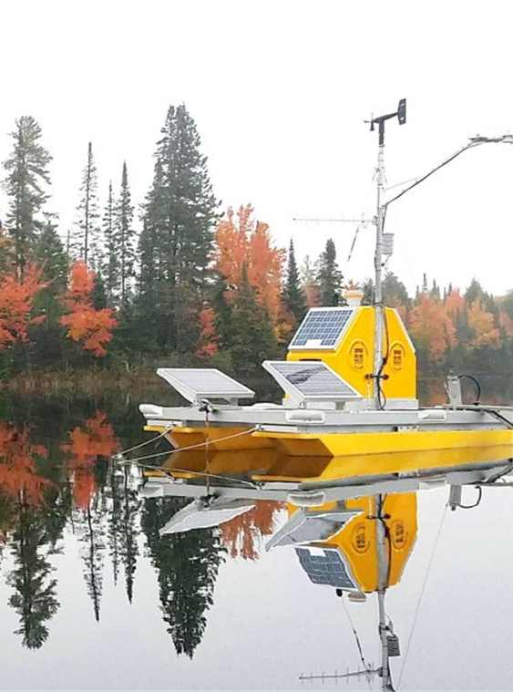
Hands-on workshop:
Water temperature = key variable in driving many biogeochemical cycles and habitat available for thermal-sensitive species
Aquatics theme – Can we predict how water temperature will change over the next month?
Water temperature in lakes
NEONs water temperature data product (DP1.20264.001)
30 day forecast horizon
Data latency of 2-3 days
Simple baseline model to build on
NEON Buoy at Crampton Lake (Land O’Lakes, WI)
Notes:
IF you are focusing on terrestrialData collected across all 47 terrestrial
Why do we care about terrestrial theme? Carbon fluxes important – natural climate solutions
How much C is being absorbed by ecosystems –
Emphasise this is just an example for the workshop

Slide 18
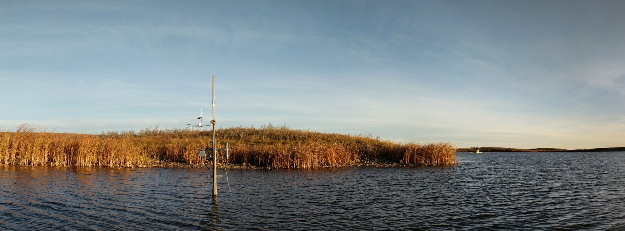
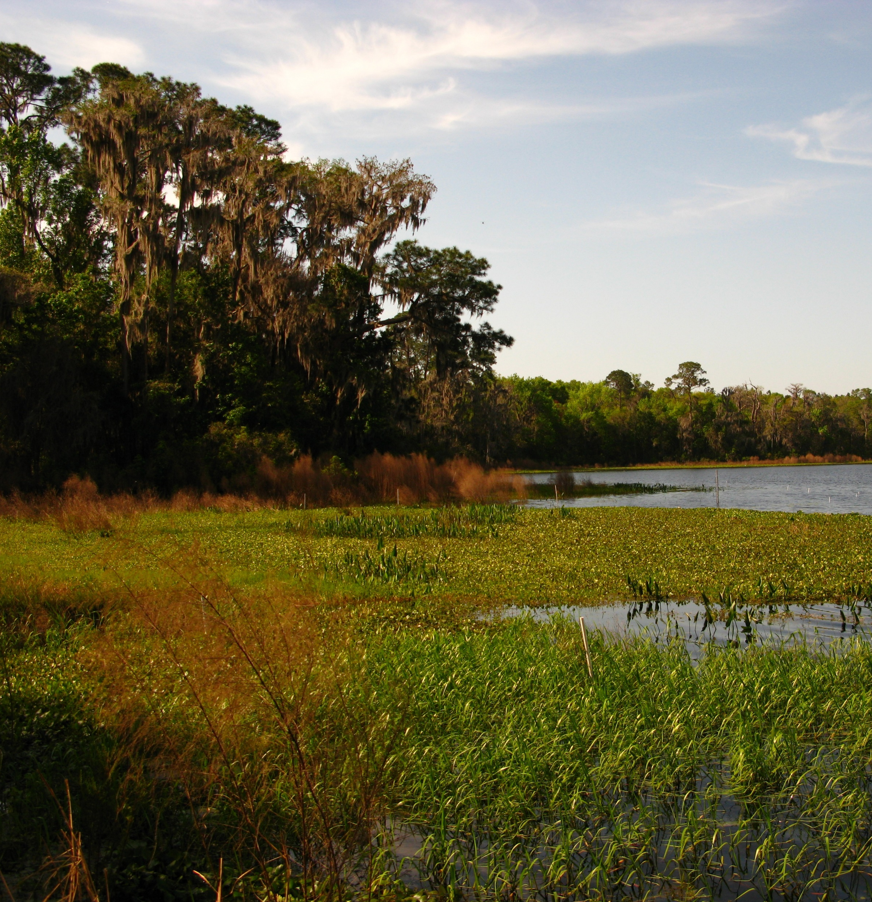
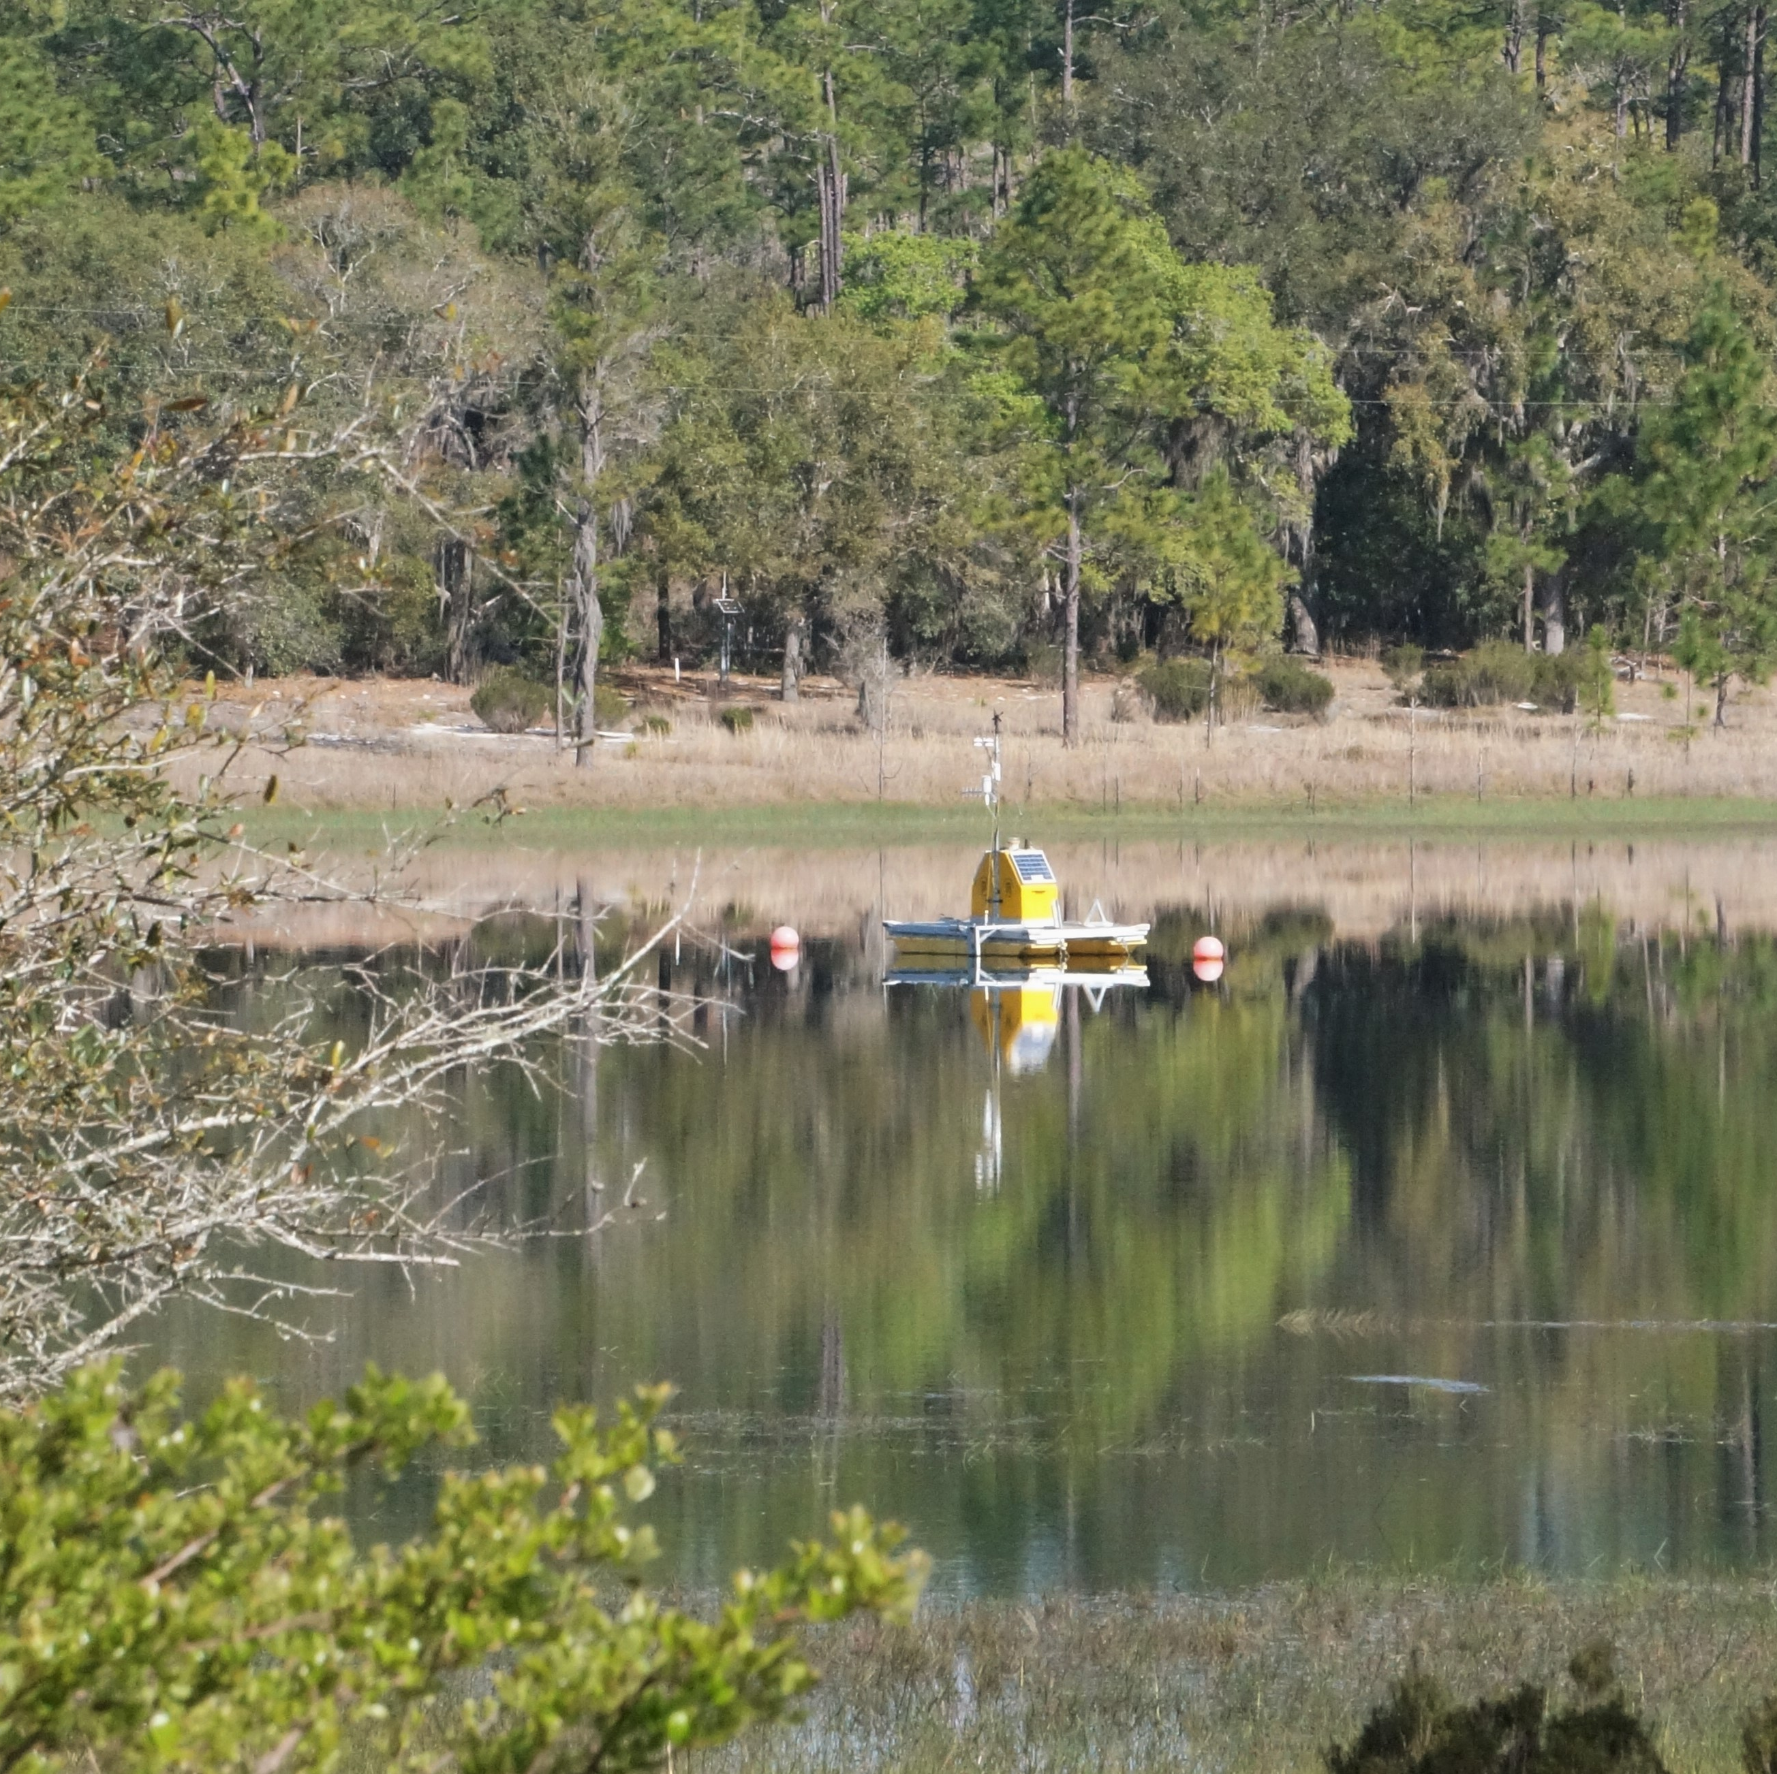
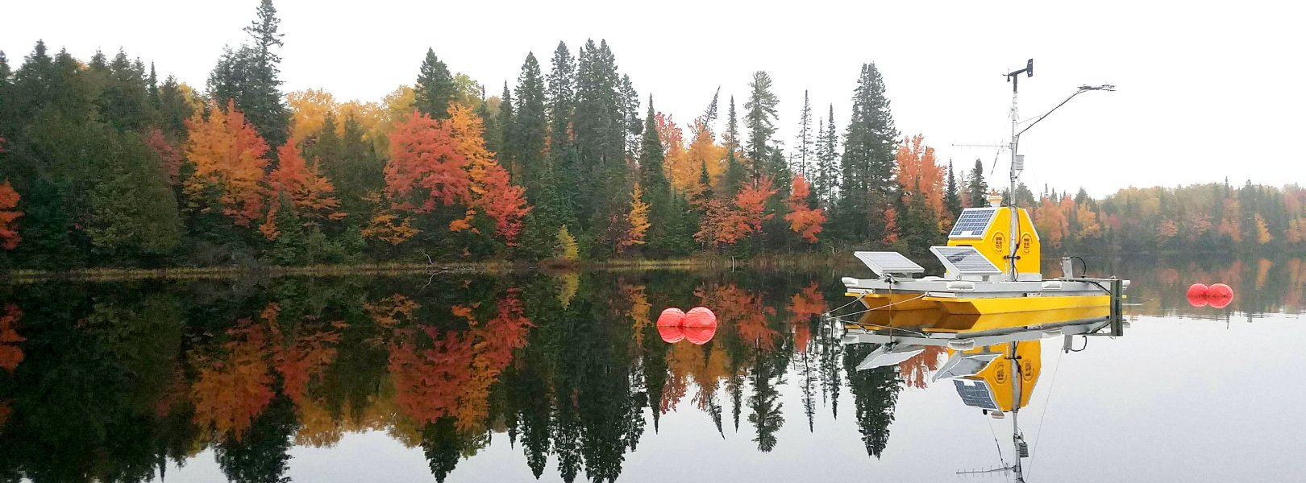
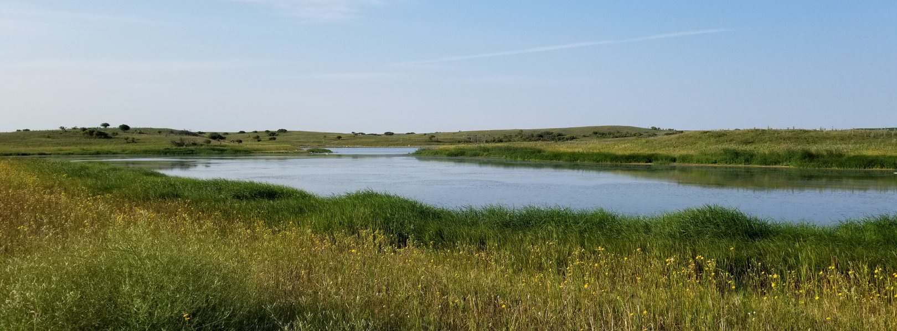
Diversity of NEON aquatic sites
Notes:
Data that we will be using is collected by automated sensors at the sites (NEON Aquatic Instrument System (AIS), see https://www.neonscience.org/field-sites/about-field-sites).
Data collected and quality checked by NEON are further processed to the targets format which is distributed to teams

Slide 19
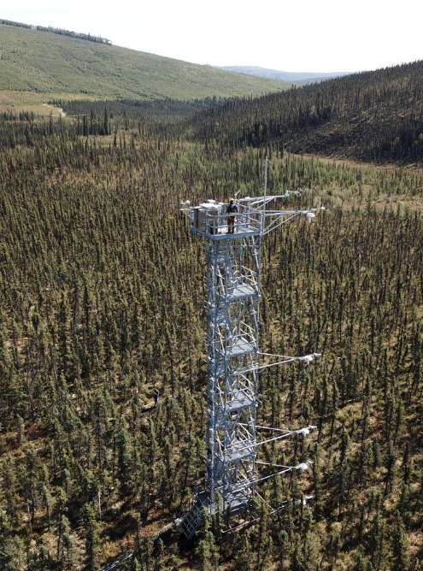
Hands-on workshop:
NEE = the net carbon balance of the ecosystem, a measurement of carbon storage rate.
Terrestrial daily theme – Can be predict how much C is going to be absorbed by ecosystems?
net ecosystem exchange (NEE)
NEONs eddy covariance data product (DP4.00200.001)
30 day forecast horizon
Data latency of 5 days
Simple baseline model to build on
NEON Eddy covariance tower at BONA (Fairbanks, AK)
Notes:
IF you are focusing on terrestrialData collected across all 47 terrestrial
Why do we care about terrestrial theme? Carbon fluxes important – natural climate solutions
How much C is being absorbed by ecosystems –
Emphasise this is just an example for the workshop

Slide 20
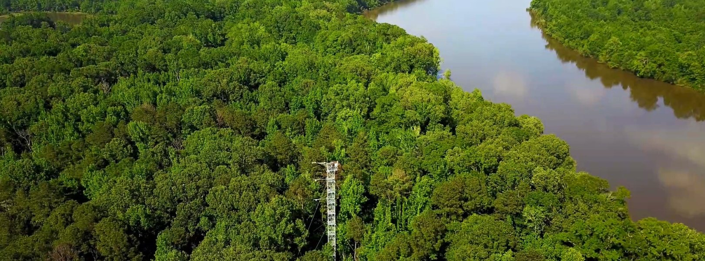
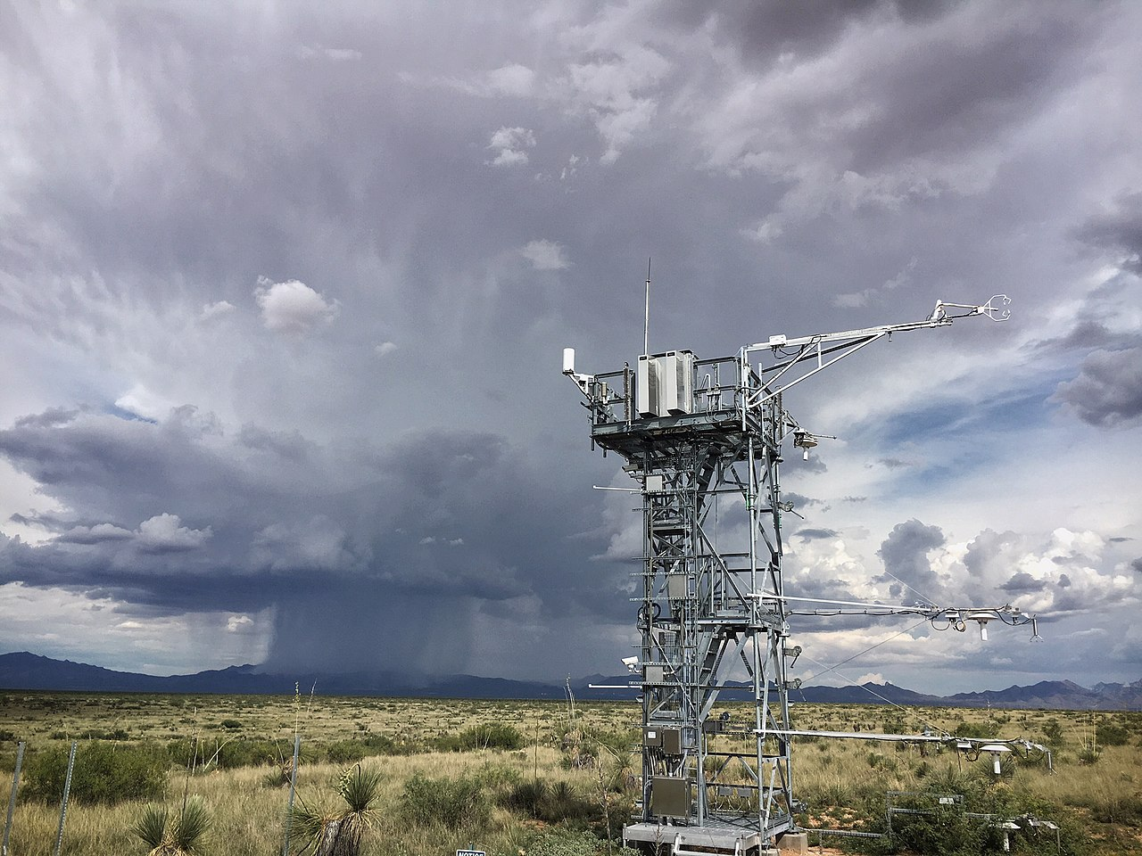
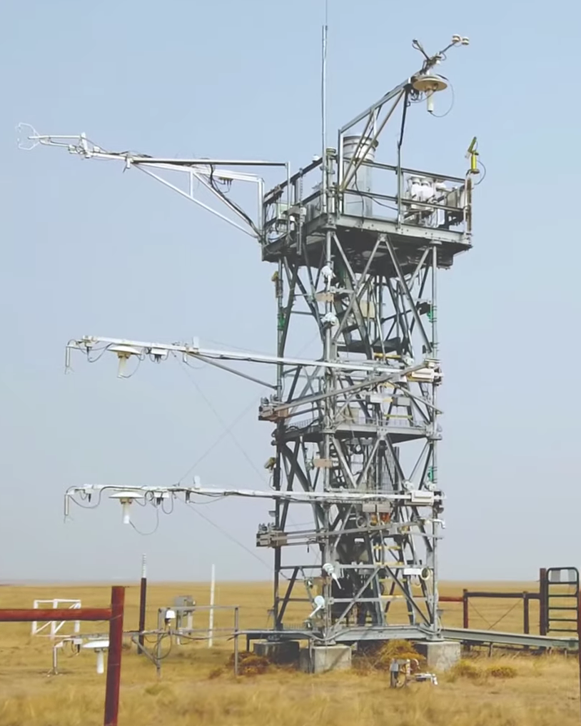
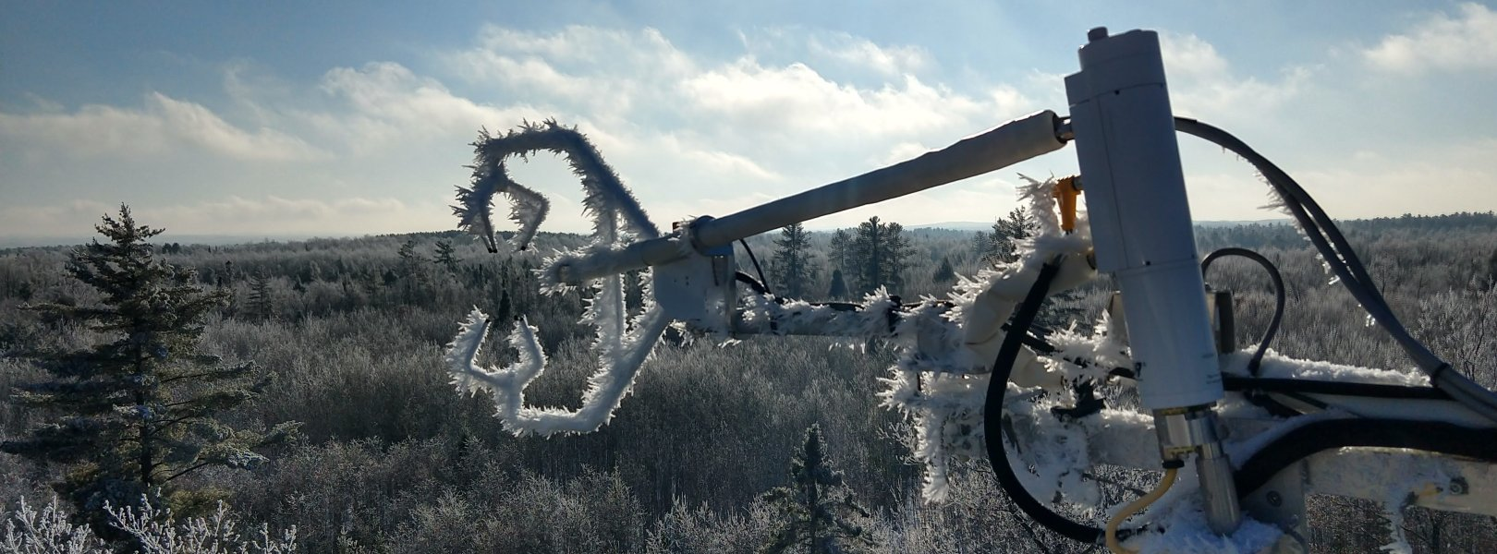
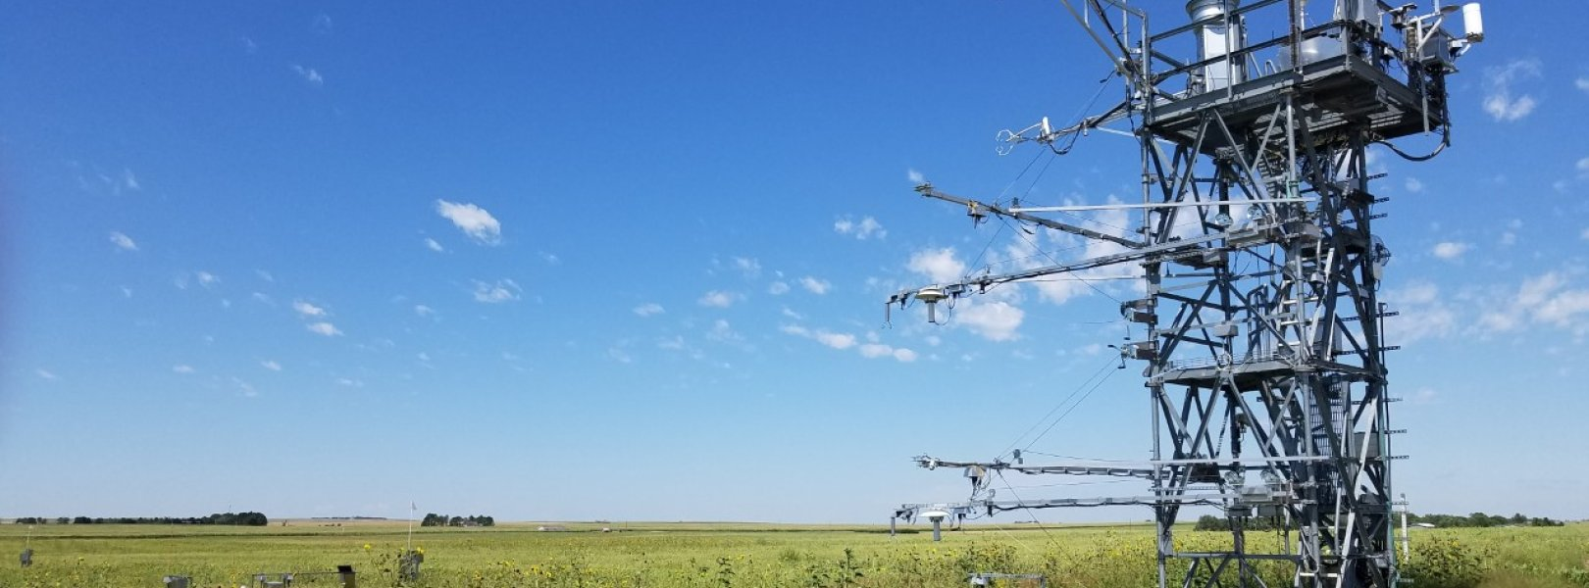
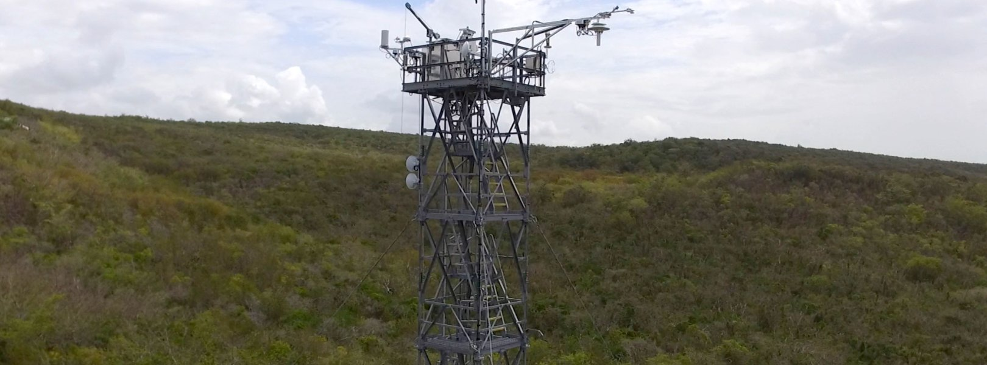
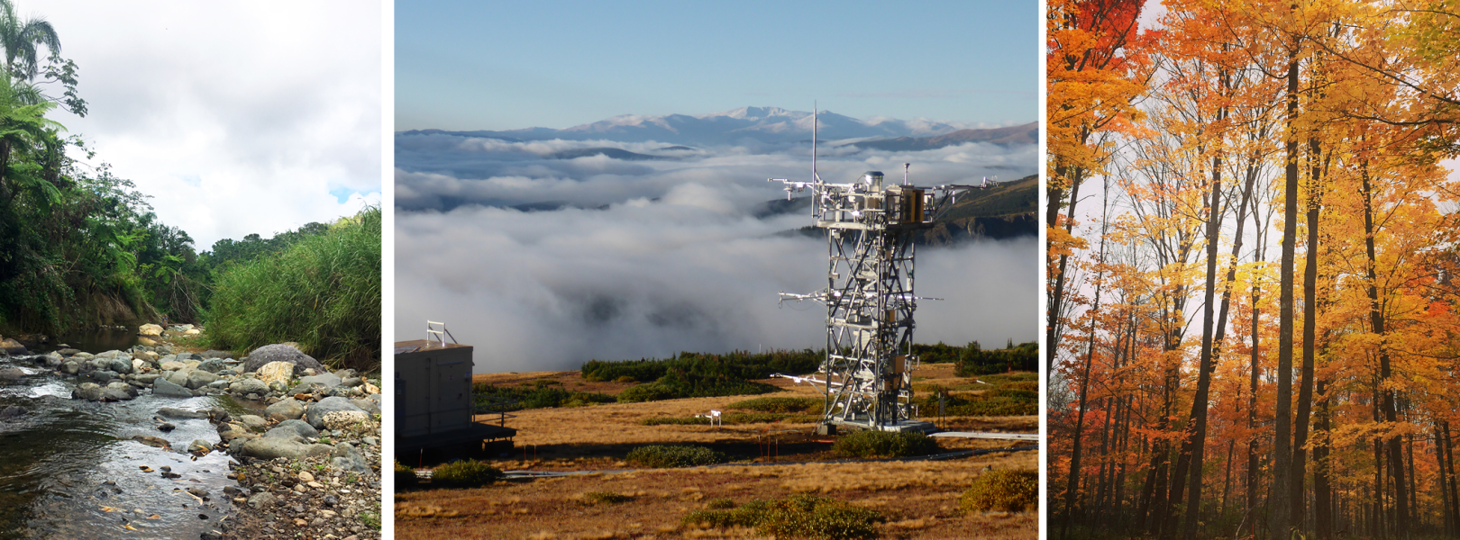
Diversity of NEON sites
Learn more: https://www.youtube.com/watch?v=CR4Anc8Mkas

Slide 21
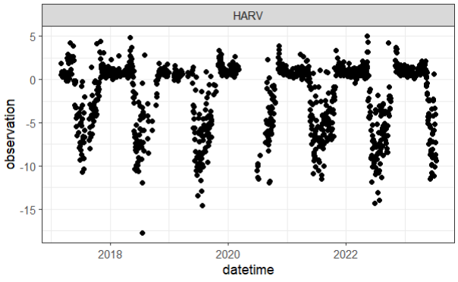
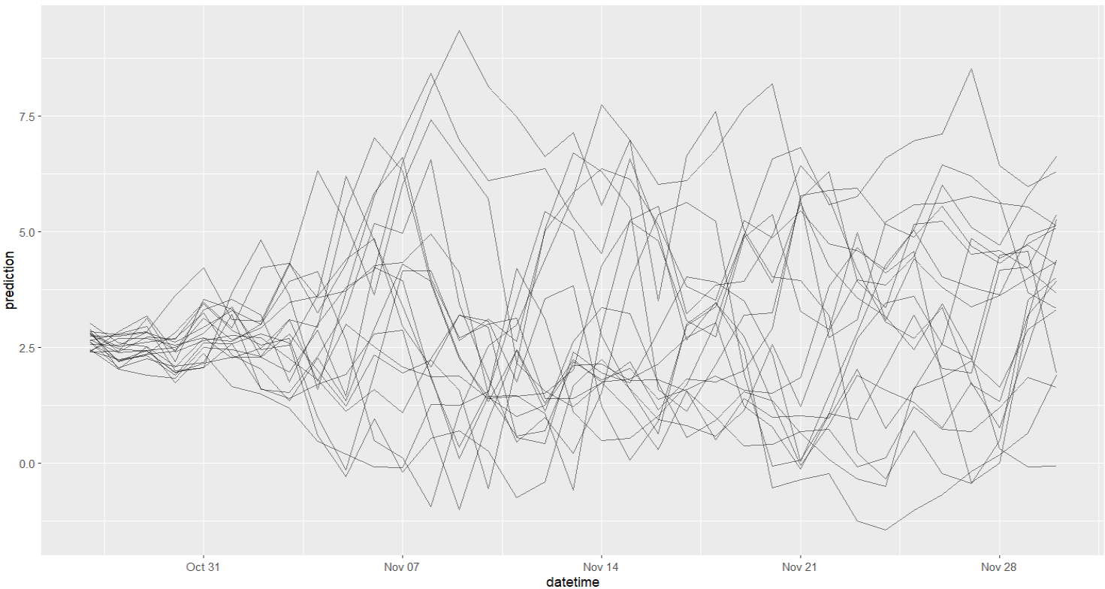
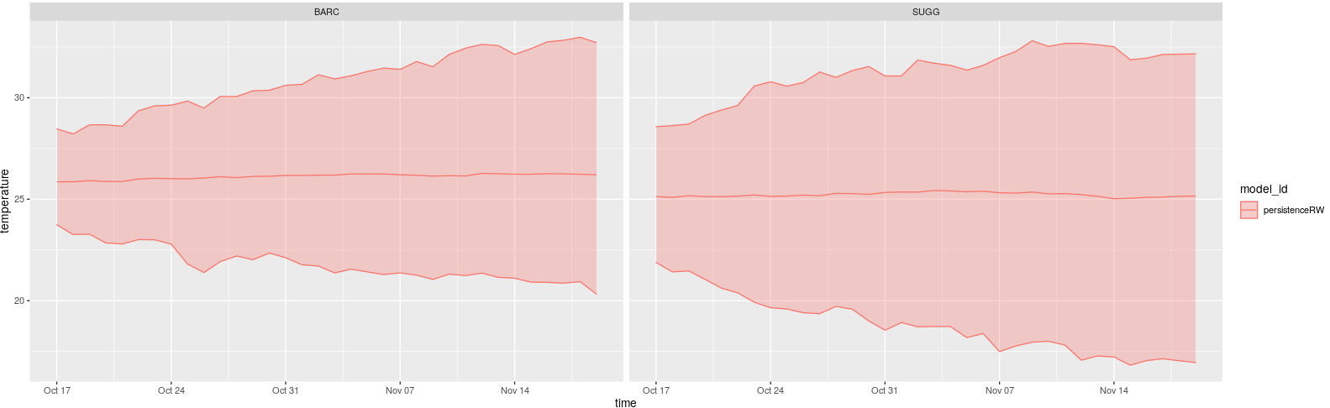
Some forecast terminology:
Targets – water temperature
Uncertainty – forecasts must include an estimate of uncertainty. The uncertainty can be represented using different model runs (ensemble members) or the statistics of the forecast (mean and standard deviation).
Notes:
Targets = what we are trying to forecast and what will be used in evaluation
Forecasts are inherently uncertain and there needs to be some estimate of what this is. This can be presented in one of two ways – an ensemble forecast that has multiple simulations of the future or by reporting the mean and standard deviation

Slide 22
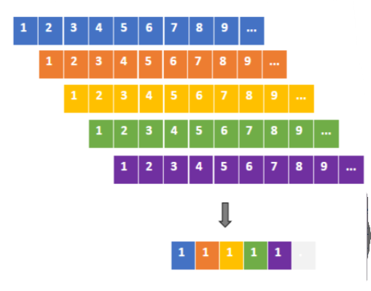
Some more forecast terminology:
NOAA data – National Oceanic and Atmospheric Administration weather forecasts
3 NOAA forecast data products available in neon4cast:
Stage_1: raw forecasts from NOAA. 30 member ensemble forecast
Stage_2: processed from stage_1 Recommended for future forecasts. Hourly inputs
Stage_3: the historic data product. A 'stacked' data set taking every 1 day ahead forecast. Useful for model training/calibration.
Notes:
We will be using NOAA weather forecast products in our predictions. These forecasts have multiple simulations so teams can include this as a source of uncertainty in their ecological forecasts. Challenge organisers have compiled 3 data products that all teams can use to drive models and ensure consistency between ecological forecasts. These are the stage 1 and 2 data – the raw and processes ensemble weather forecasts. They have also developed an estimate of historical conditions called a stacked data product which can be used to train models. Takes all the 1 day ahead forecasts as a good estimate of observed conditions.
This gives a consistent data product that can be used for training and deployment

Slide 23
A little more forecast terminology:
Scores – a means to assess forecast skill. The Challenge uses the Continuous Rank Probability Score (crps). Uses both the accuracy (mean) and the precision (sd) of the forecast.
Scores → Dashboard → Users!
Read more: https://projects.ecoforecast.org/neon4cast-docs/Evaluation.html
Notes:
Some other terms that I might use but you don’t need to worry too much about are the scores – this is how the submitted forecasts are evaluated, how well did we do at forecasting the future. The method used by the Challenge incorporates the accuracy and the precision of the forecast – so how close where the predictions to the observation and how certain were we about that.
Scores are automatically generated and pushed to the dashboard for teams to see.
Read more about scores here https://projects.ecoforecast.org/neon4cast-docs/Evaluation.html

Slide 24
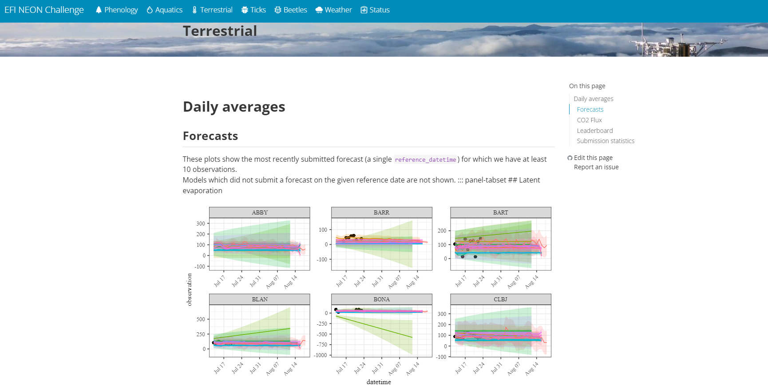
https://projects.ecoforecast.org/neon4cast-dashboard/
Notes:
Dashboard

Slide 25

A little more forecast terminology:
Standards - Help maintain consistency in forecast generation, submissions and scoring
Need to submit a forecast in a standardized format
file format (csv or NetCDF)
file name format ([theme]-[reference_datetime]-[team_name].csv)
specific column names
column format (datetime/character/integer/etc.)
Notes:
The standards are a set of requirements for formats etc. that help consistency and the automate methods – things need to have particular names and formats.
See here https://projects.ecoforecast.org/neon4cast-docs/Submission-Instructions.html

Slide 26












Slide 27
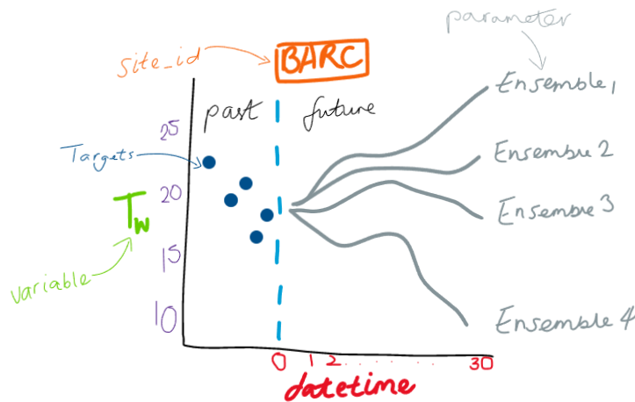
datetime | reference_datetime | site_id | family | parameter | variable | prediction | model_id
2023-01-12 | 2023-01-11 | BARC | ensemble | 1 | temperature | 22.63563 | test_mod
2023-01-12 | 2023-01-11 | BARC | ensemble | 2 | temperature | 26.75148 | test_mod
2023-01-12 | 2023-01-11 | BARC | ensemble | 3 | temperature | 24.65157 | test_mod
2023-01-12 | 2023-01-11 | BARC | ensemble | 4 | temperature | 25.1389 | test_mod
… | … | … | … | … | … | … | test_mod
2023-02-10 | 2023-01-11 | BARC | ensemble | 1 | temperature | 19.40379 | test_mod
2023-02-10 | 2023-01-11 | BARC | ensemble | 2 | temperature | 24.89667 | test_mod
2023-02-10 | 2023-01-11 | BARC | ensemble | 3 | temperature | 25.98961 | test_mod
2023-02-10 | 2023-01-11 | BARC | ensemble | 4 | temperature | 26.40593 | test_mod
Notes:
Update the dates to more recent to reflect what participants might see

Slide 28
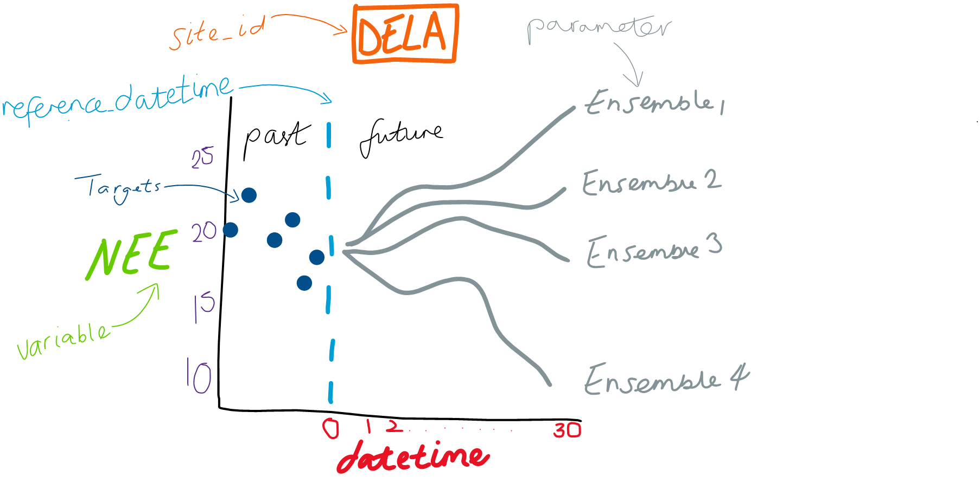
Notes:
To put that all together this is what a forecast might look like. This is an ensemble forecast of NEE (our target)

Slide 29
datetime | reference_datetime | site_id | family | parameter | variable | prediction | model_id
2023-08-02 | 2023-08-01 | DELA | ensemble | 1 | nee | 5.551 | test_mod
2023-08-02 | 2023-08-01 | DELA | ensemble | 2 | nee | 4.547 | test_mod
2023-08-02 | 2023-08-01 | DELA | ensemble | 3 | nee | 2.227 | test_mod
2023-08-02 | 2023-08-01 | DELA | ensemble | 4 | nee | 3.214 | test_mod
… | … | … | … | … | … | … | test_mod
2023-09-02 | 2023-08-01 | DELA | ensemble | 1 | nee | 6.852 | test_mod
2023-09-02 | 2023-08-01 | DELA | ensemble | 2 | nee | 2.247 | test_mod
2023-09-02 | 2023-08-01 | DELA | ensemble | 3 | nee | 5.961 | test_mod
2023-09-02 | 2023-08-01 | DELA | ensemble | 4 | nee | 4.593 | test_mod
Notes:
In a csv format that meets standards it might look like this. One important thing to understand is the idea of a reference_Datetime or the date when the forecast was generated. Here you can see the forecast was generated on 1st August and goes out 30 days into the future. Family and parameter describe the type of forecast it is – family is ensemble and the parameter is the ID of each ensemble member

Slide 30
Basic workflow to submit a forecast
Read EFI-NEON Challenge documentation (neon4cast.org)
Investigate the forecast target variables
Build/apply your model!
Produce forecast of future conditions – SUBMIT TO THE CHALLENGE!
Register, complete model description, and submit your forecasts
Wait for the scores to come in and revel in the glory of predicting the future (~5-day before first evaluation)
Use new data to update the model
Submit another forecast! And another…!
Workflow automation
Notes:
What the workflow might look like. Lots of great documentation and templates and tools to help you get started
Get involved in the iterative nature of forecasting, submit/improve your forecast every day. Use data assimilation techniques to modify starting conditions

Slide 31
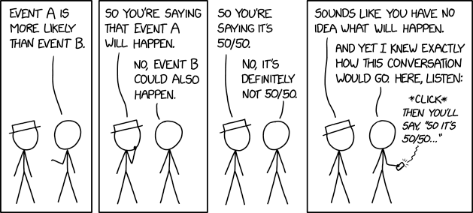
Questions?
https://xkcd.com/2370

Slide 32
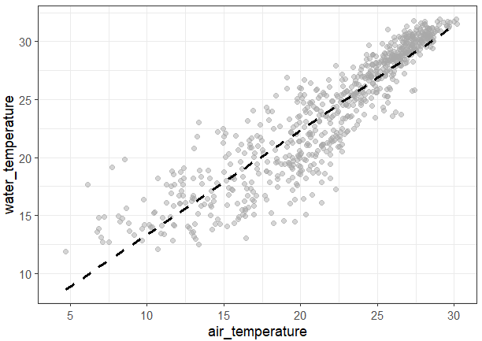
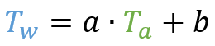
Let’s forecast!
Follow-along R markdown
Forecasting water temperature using a Linear model with air temperature
Modify the model and submit your forecast!
More/other covariates
Different model structures
Other variables
Notes:
Time for quesitons

Slide 33
Let’s forecast!
Follow-along R markdown
Forecasting Net Ecosystem Exchange using a Linear model with air temperature and short-wave radiation
Or just watch along!
Modify the model and submit your forecast!
More/other covariates
Different model structures
Other variables
$$NEE=c+b∙AT+a∙SWR$$
Notes:
Time for questions

Slide 34
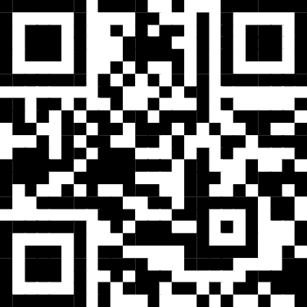
Installation instructions
https://tinyurl.com/3t7hrk8e
Notes:
Update url

Slide 35
Thank you for attending!
Big thanks to the EFI-NEON team - especially Quinn Thomas (Virginia Tech) and Carl Boettiger (UC-Berkley)
Tech assistants
If you would like some help getting your forecasts up and running during ESA – email me to set up a time!
freyao@vt.edu
Visit ecoforecast.org & neon4cast.org

